Slide 1
TIME WISE
BY
S. MARIYAMMA

Slide 2

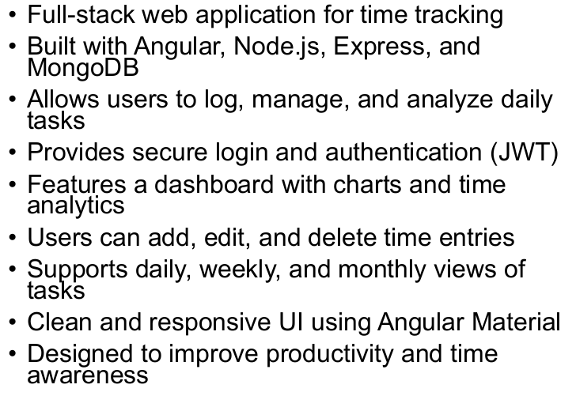

Slide 3

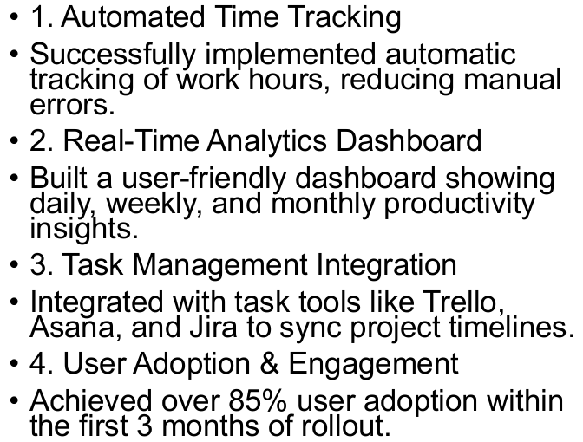

Slide 4

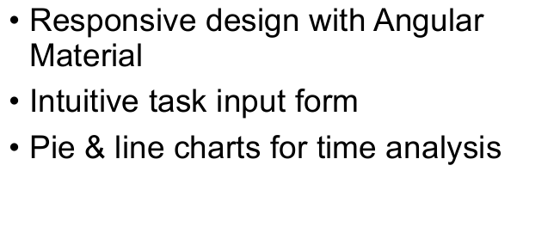

Slide 5

